Slide 1

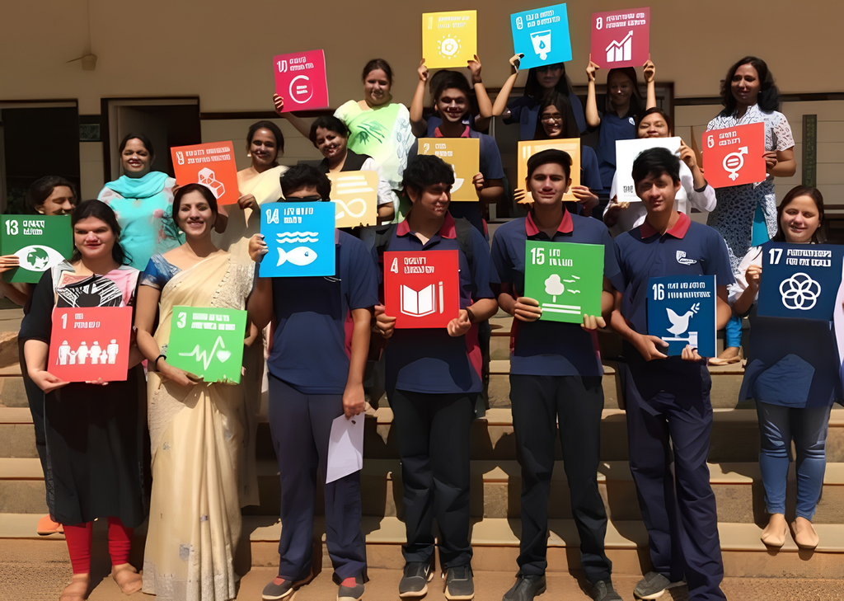
PROJECT TITLE:
WASTE SEGREGATION & PLASTIC REDUCTION
VIDYASHILP ACADEMY, BANGALORE

Slide 2

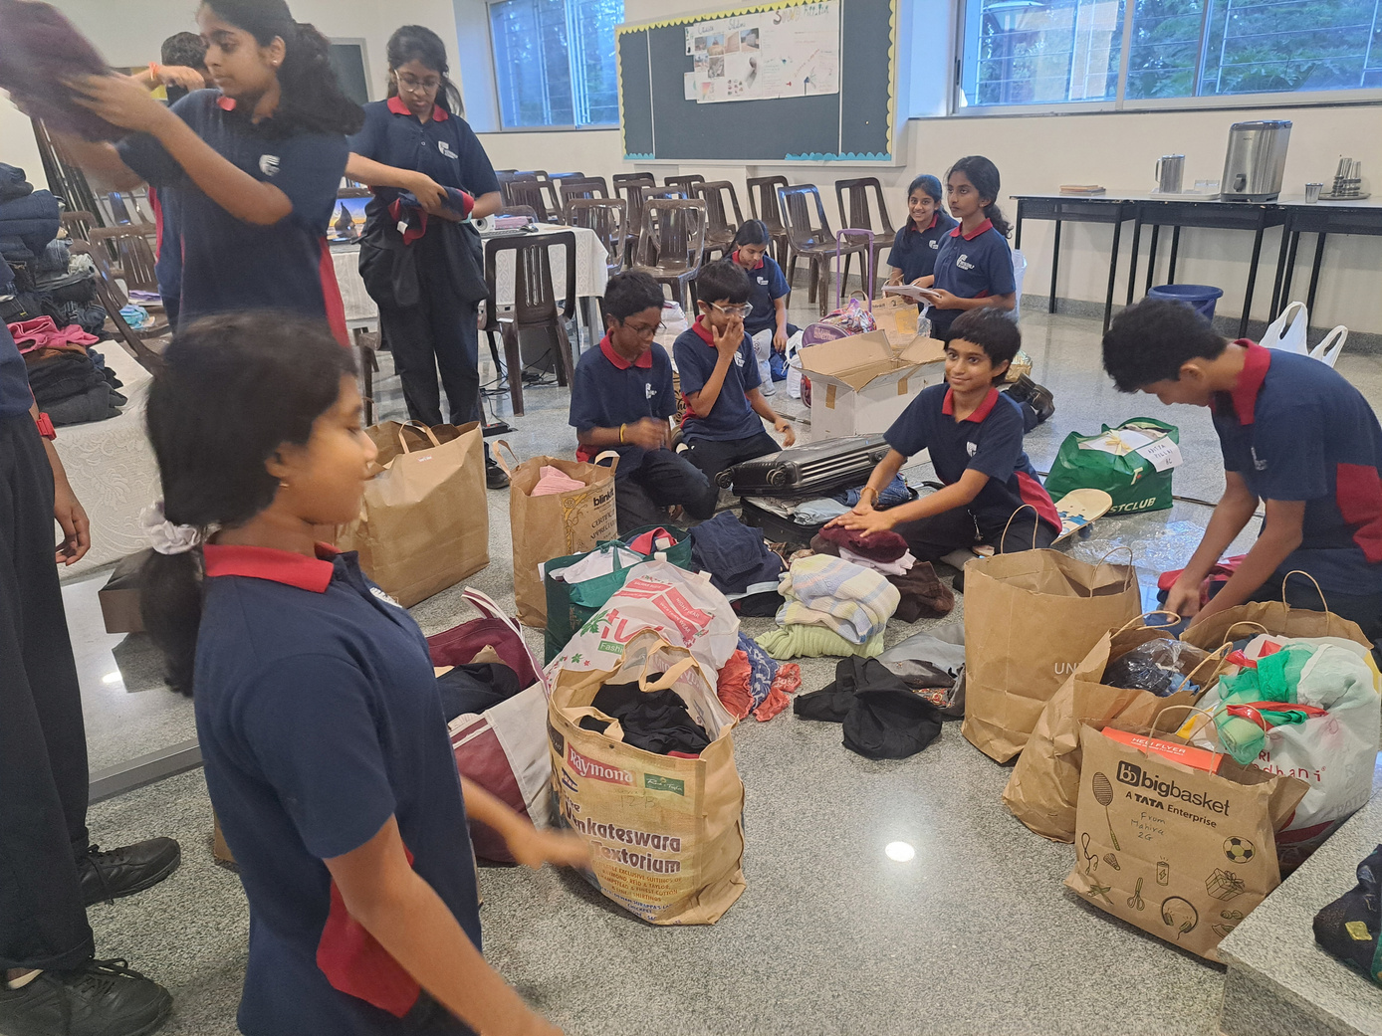
BUILDING A SUSTAINABLE SCHOOL ECOSYSTEM
PROJECT AIM
Our Campus Waste Segregation and Plastic Reduction initiative aims to build a zero-waste community where sustainable choices become a way of life. By reducing plastic use, strengthening waste segregation, and promoting reuse and recycling, the initiative fosters a cleaner, more sustainable campus and a culture of responsible consumption.
PROJECT VISION
To foster responsible waste management by promoting waste segregation at source, reducing single-use plastics, and encouraging environmentally conscious practices. The initiative envisions a sustainable, circular campus where waste is transformed into valuable resources, responsible consumption becomes a daily habit, and students grow into environmentally conscious changemakers.

Slide 3
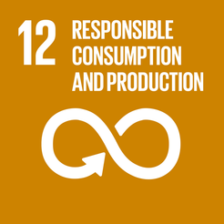
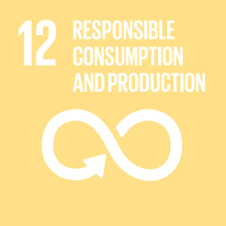
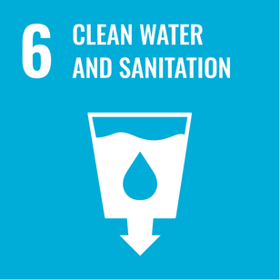


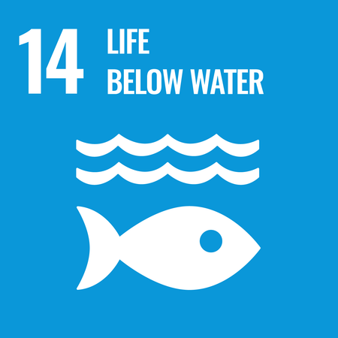
SDG ALIGNMENT
SDG 12 – Responsible Consumption and Production: Reduce waste generation and promote reuse and recycling.
SDG 6 – Clean Water and Sanitation: Support responsible wastewater management and reuse wherever feasible.
SDG 13 – Climate Action: Reduce the environmental impact associated with plastic and waste.
SDG 14 – Life Below Water: Reduce plastic and land-based pollution to help protect water bodies and aquatic ecosystems.

Slide 4



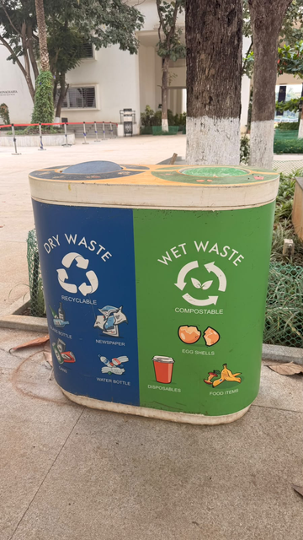

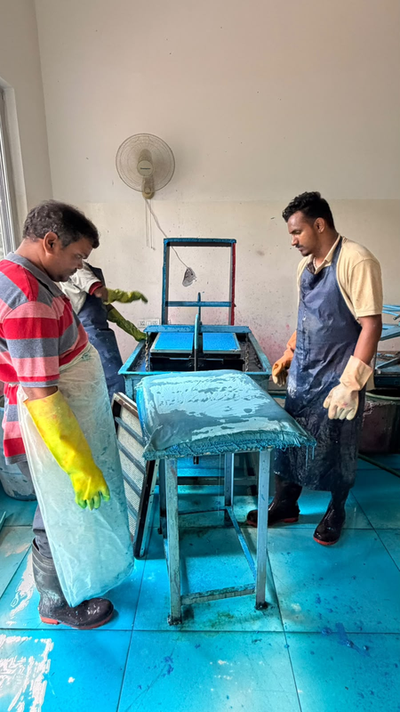
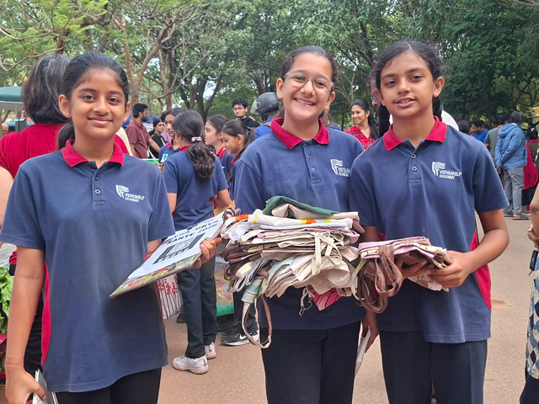
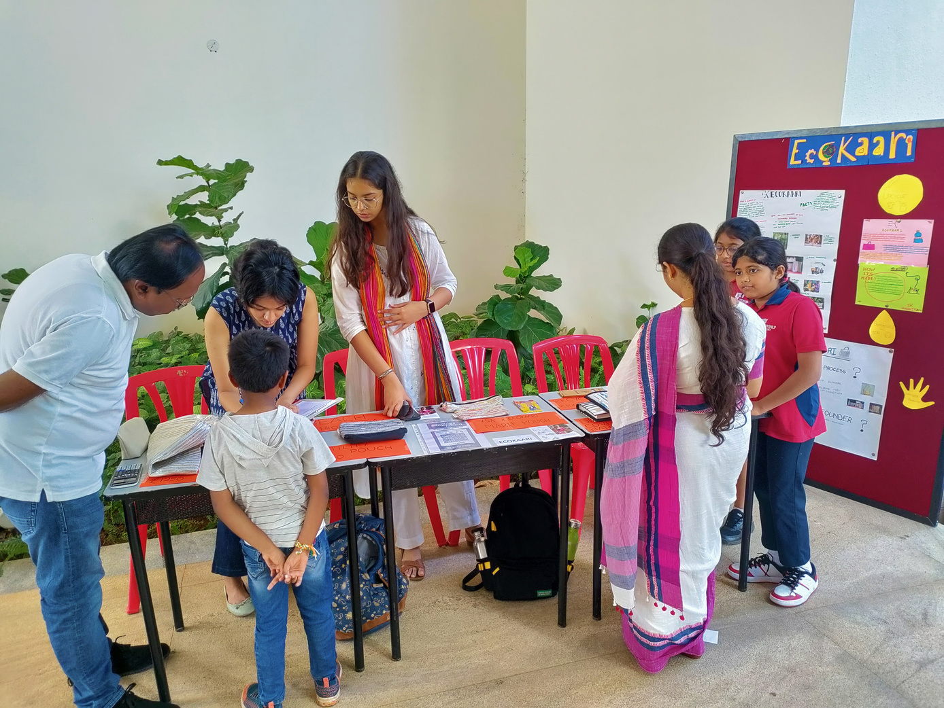
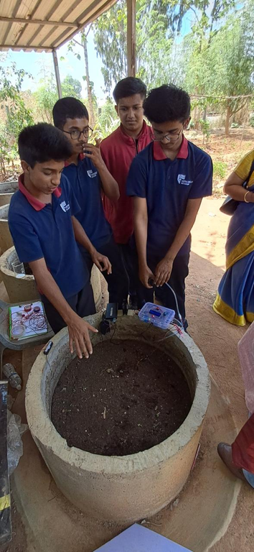
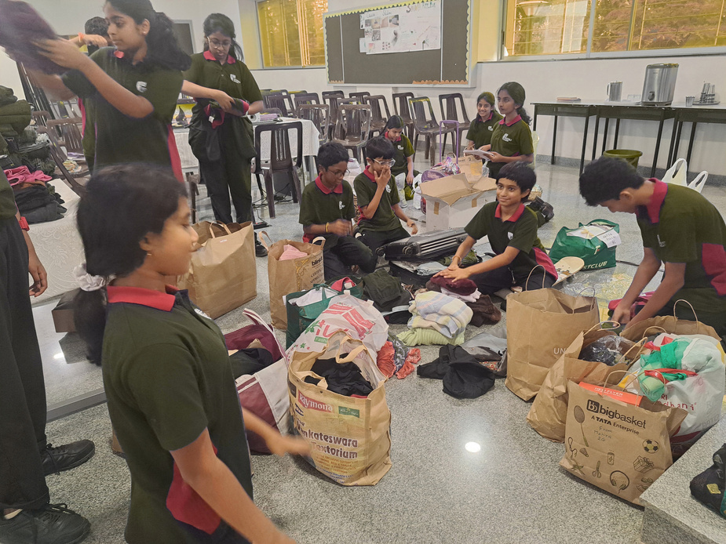
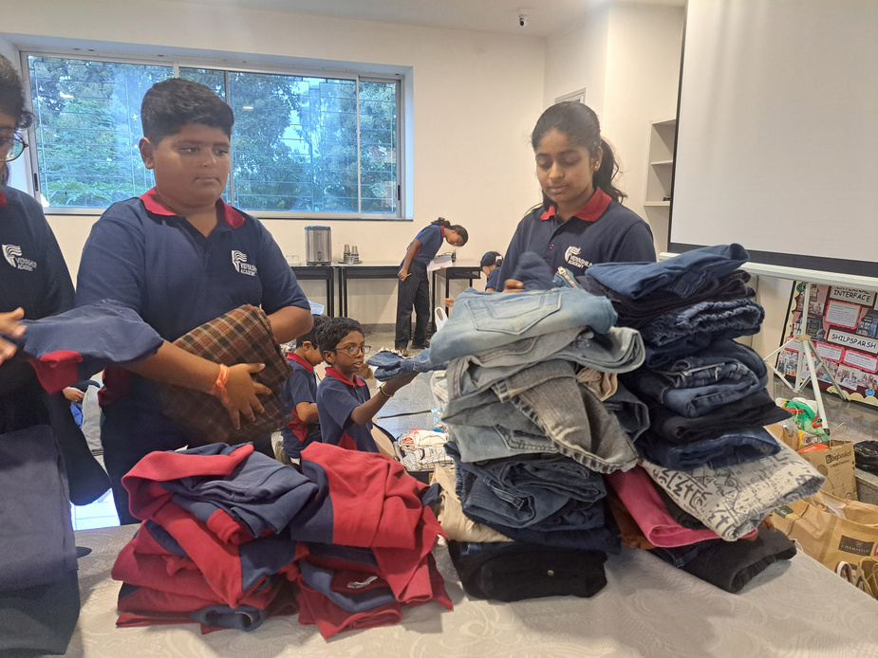
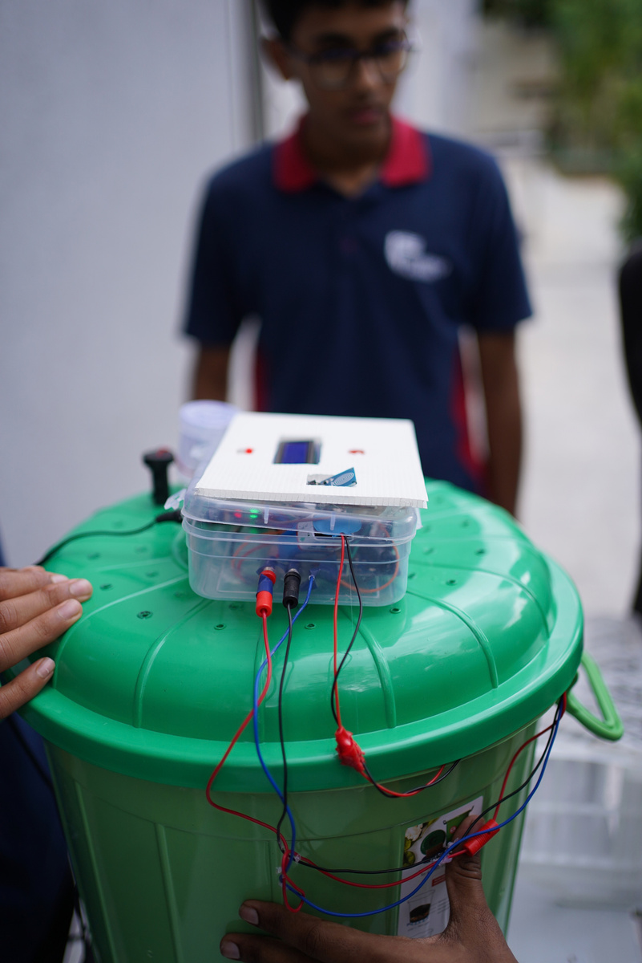
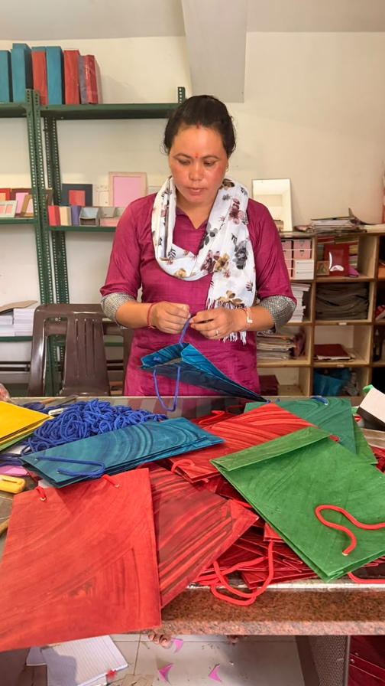
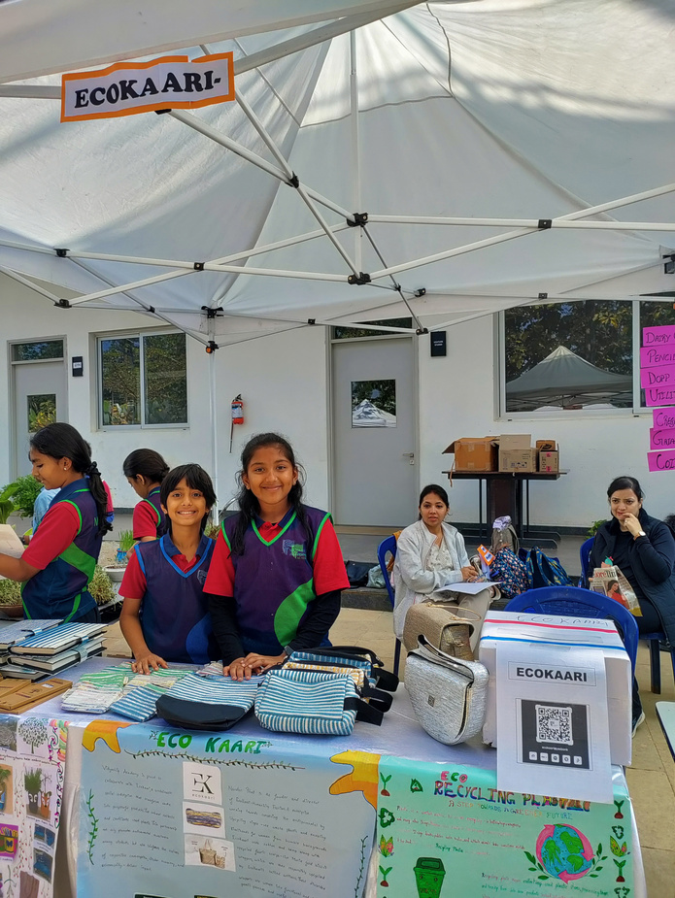
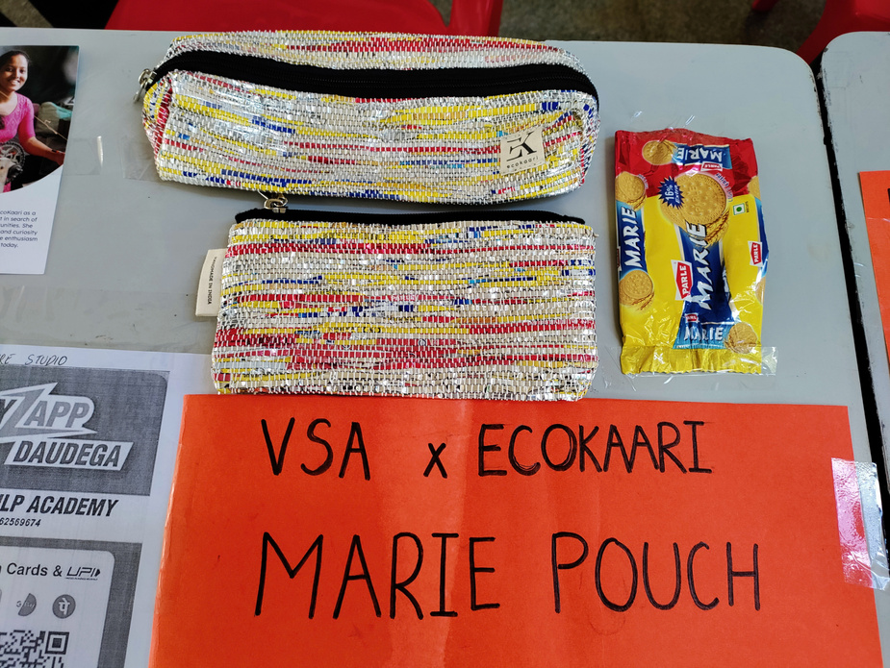

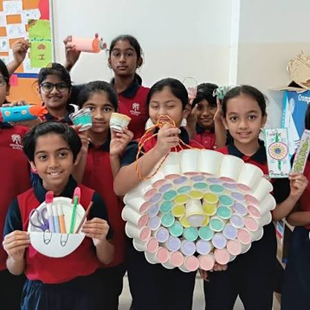
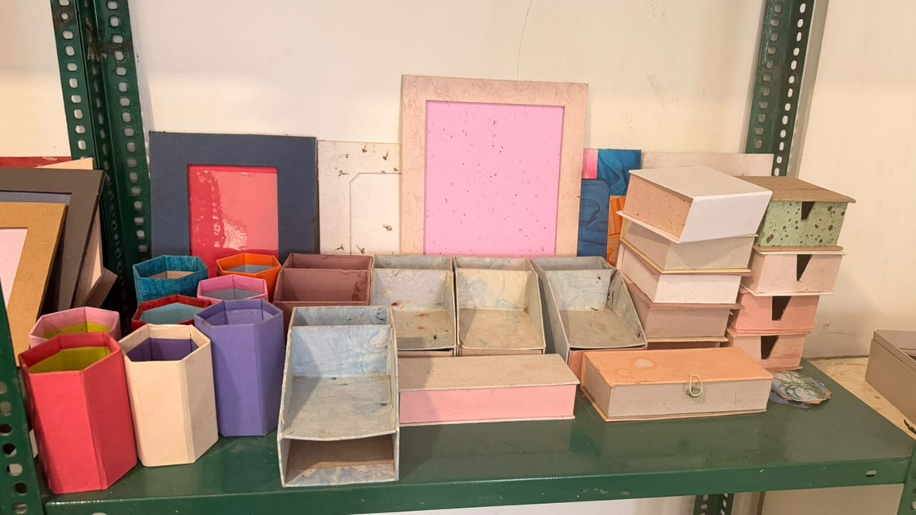
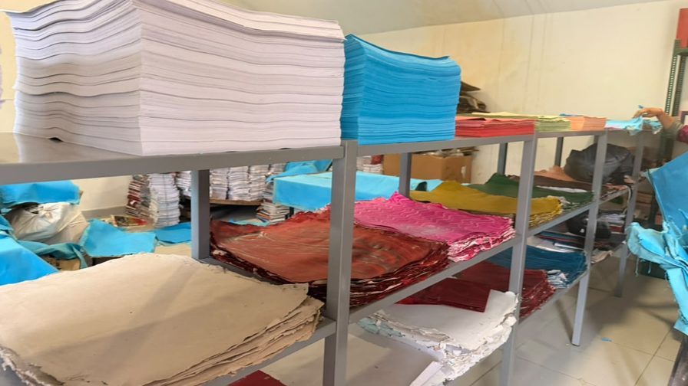
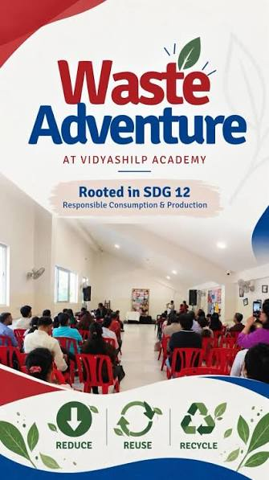
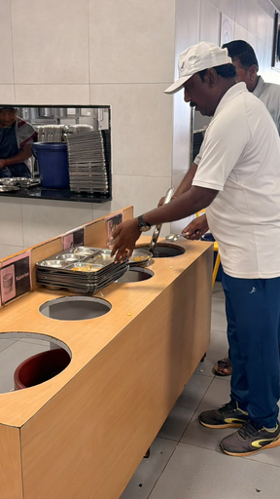
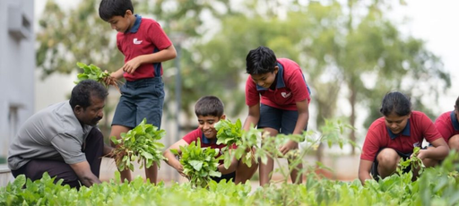
OUR COMMUNITY
Our Campus Waste Segregation and Plastic Reduction initiative promotes responsible waste management through the collective involvement of students, teachers, staff, vendors, parents and the wider school community.

Slide 5
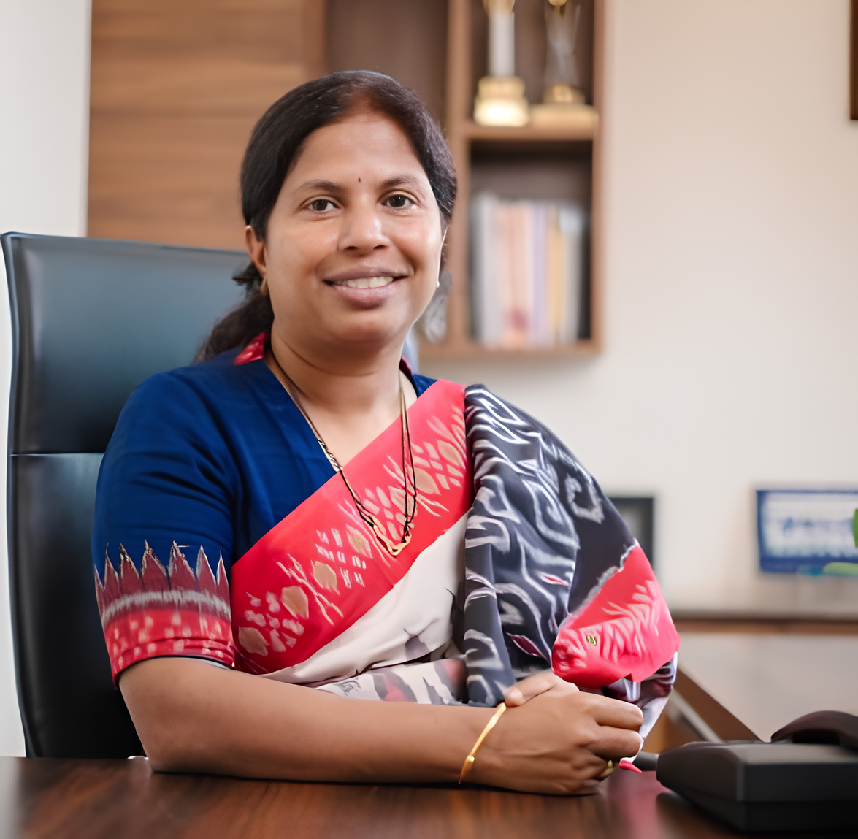

MESSAGE FROM OUR HEAD OF SCHOOL
OUR SUSTAINABILITY VISION
Sustainability is becoming an integral part of our school’s ecosystem. We see our students internalizing these concepts deeply and taking small steps. Their passion to make change in their lives and in the surrounding that now resulting in scalable projects that are receiving recognition nationally and internationally. Individual actions are becoming a movement and we are extremely happy to be part of this snowball effect.
Ms. Kalai Selvi
Head Of School

Slide 6
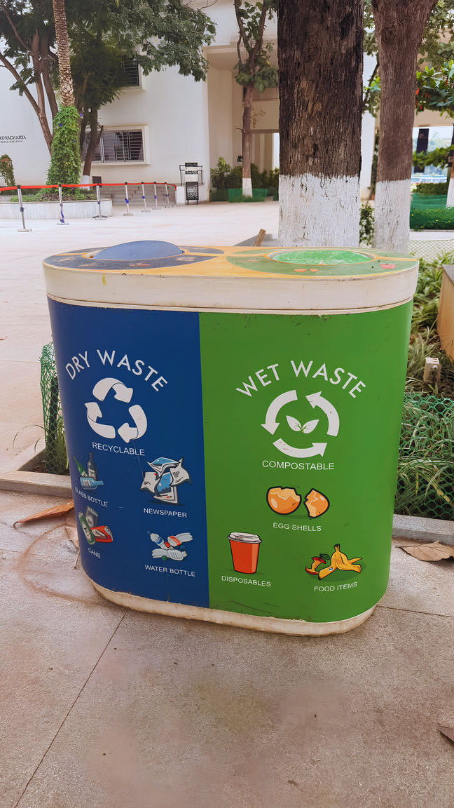
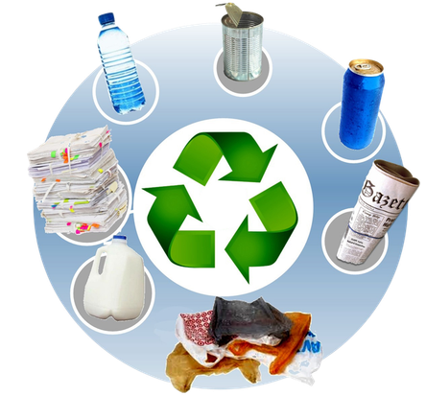
Campus-Wide Waste Segregation
Segregation bins are placed across the campus to encourage waste segregation at source and support responsible waste disposal.
    Plastic waste segregation: Plastic waste generated on campus is collected separately and channelled for productive reuse rather than being mixed with general waste.
    Art Department & Paper Recycling Unit: Selected plastic waste is given to the Art Department, where students use it for creative activities and transform it into useful or innovative products.
    STEM Department & Atal Tinkering Lab (ATL): Plastic materials are reused as learning and making resources for STEM projects and student activities.
    Students use suitable discarded plastic materials for tinkering, prototyping and developing useful products, giving waste a second life.

Slide 7
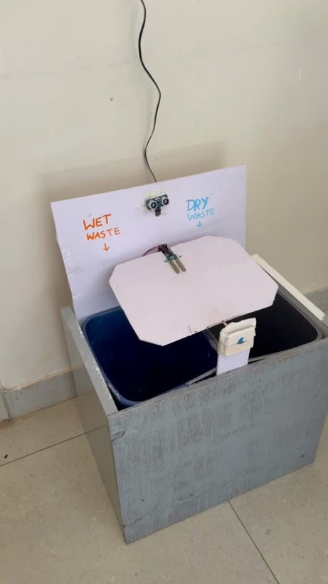
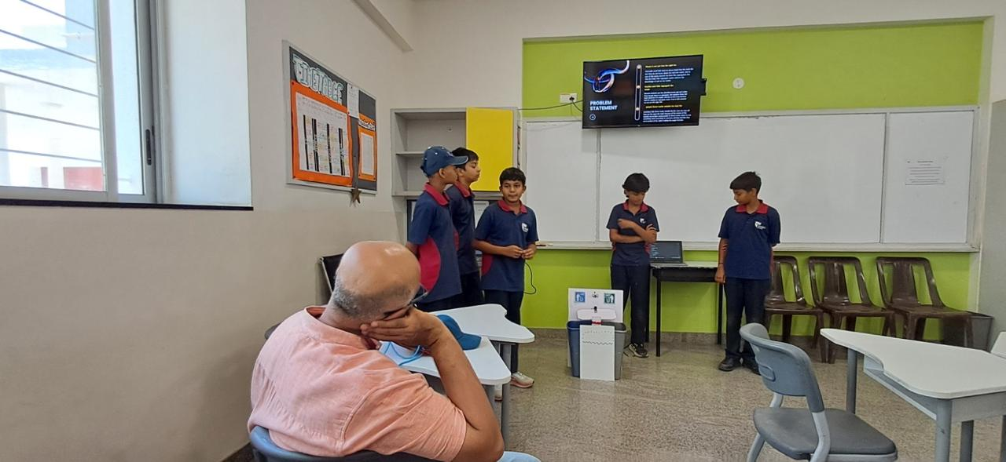
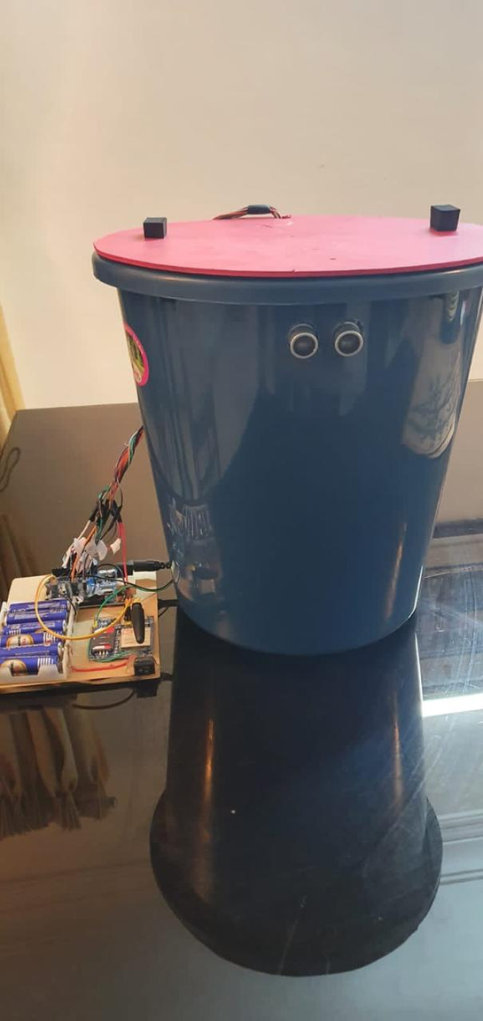
Applying Electronics and IoT to Responsible Waste Management
ATL Student Innovation
Students have developed a technology-enabled waste segregation prototype exploring how electronics, sensors, and automation can support responsible waste management. which is deployed in the classrom
The project demonstrates how technology can be applied to improve waste management practices and encourage responsible disposal.
Automated Wet/Dry Waste Segregation Bin
Students presented their idea to AIM representatives and distinguished leaders from academia and industry

Slide 8
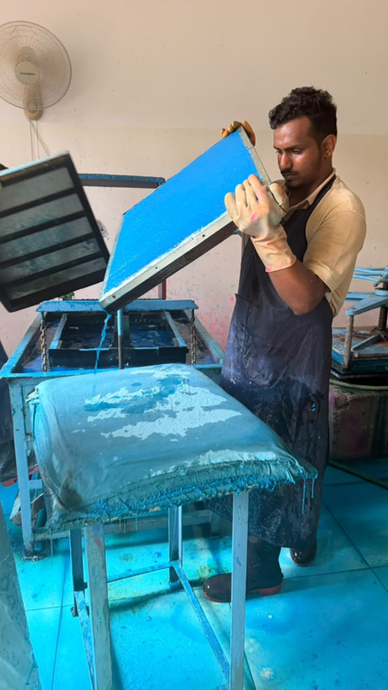
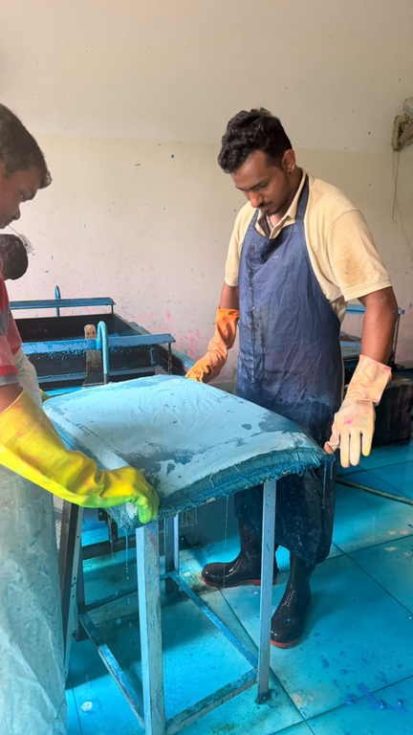

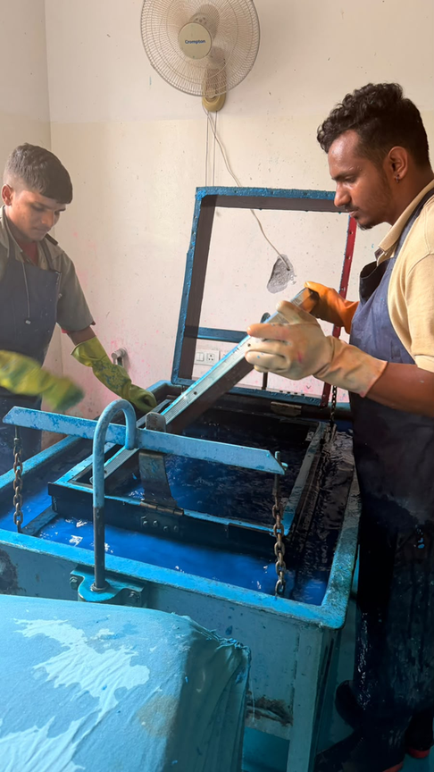
Collection and Processing of discarded papers
SCHOOL-BASED PAPER RECYCLING UNIT
The initiative promotes a circular approach to resource use by turning the school’s paper waste into useful products, helping reduce reliance on newly sourced and plastic-based materials.
  Paper waste is collected from classrooms and designated collection points.
  The Paper Recycling Unit is housed in a dedicated room and comprises separate machines for pulping, screw pressing, drying, and smoothing the paper.
  Trained staff operate the equipment and carry out the paper-recycling process.

Slide 9
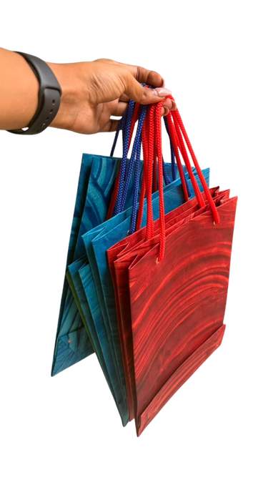
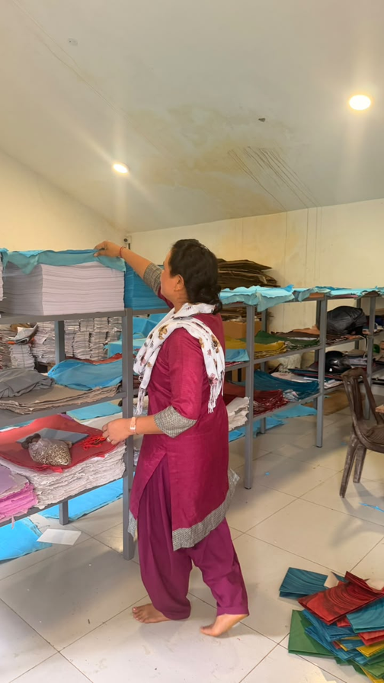
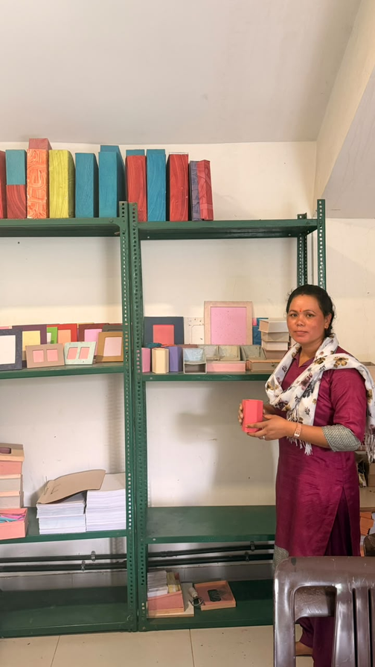
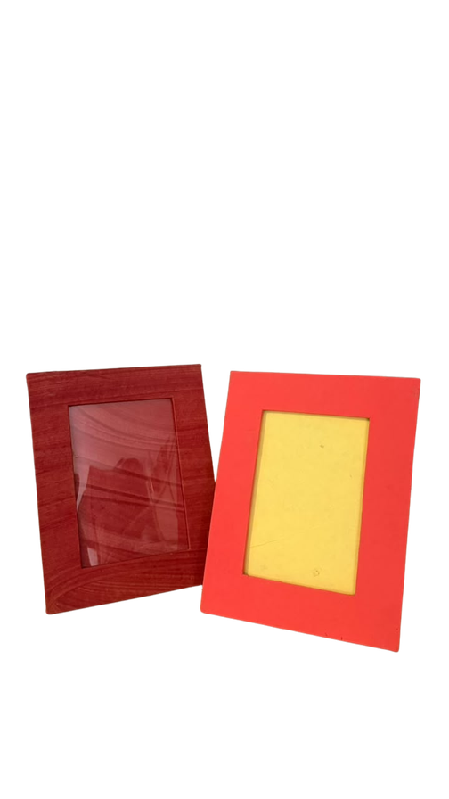
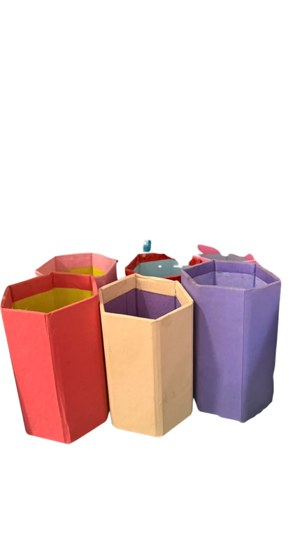

From Paper Waste to Everyday Products
SCHOOL-BASED PAPER RECYCLING UNIT
Products Made:
    Notebooks and books for student use
    Paper pen holders
    Frames
    Files and folders
    Other stationery and utility products
    Paper Bags
The school’s Paper Recycling Unit processes approximately 40 kg of waste paper per day, producing around 800 recycled sheets.

Slide 10
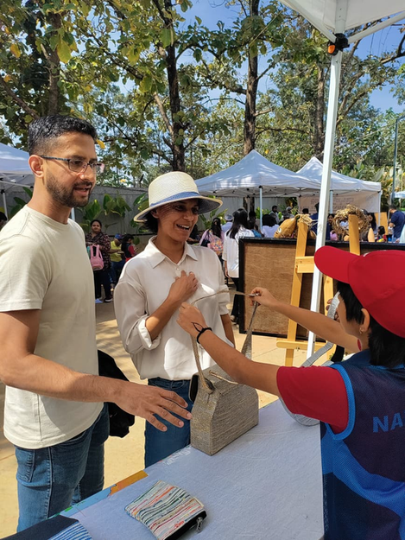
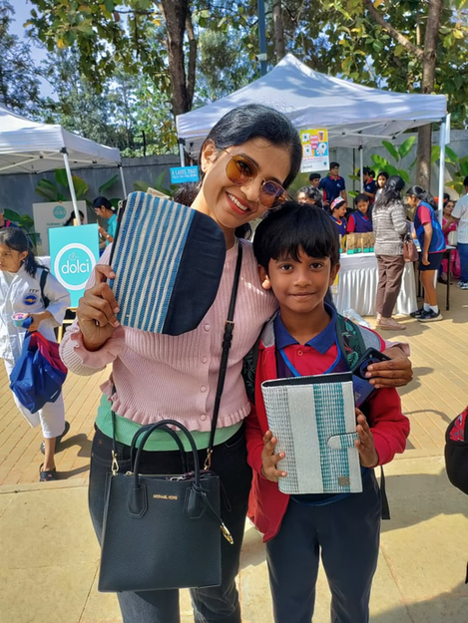
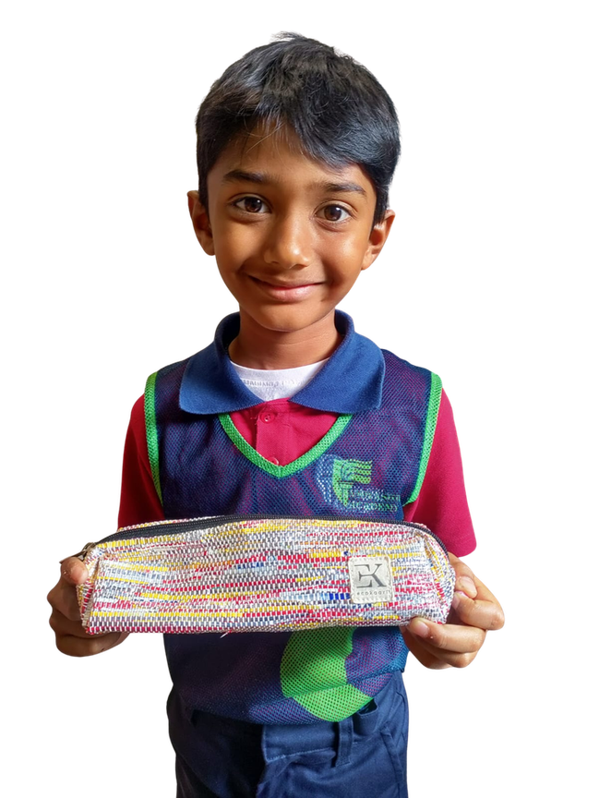
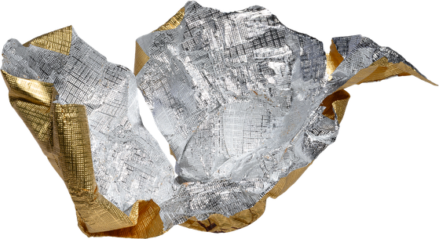

Plastic Wrapper Upcycling Workshop with EcoKary collaboration.
Creative
Plastic Upcycling Process
Students participated in a hands-on plastic wrapper upcycling workshop, learning to transform separately collected wrappers from chocolates, biscuits, and school celebrations into useful products such as pouches and carry bags.
Their creations were displayed and sold at stalls during school events and open days, giving students an opportunity to showcase their work and develop entrepreneurial skills.

Slide 11
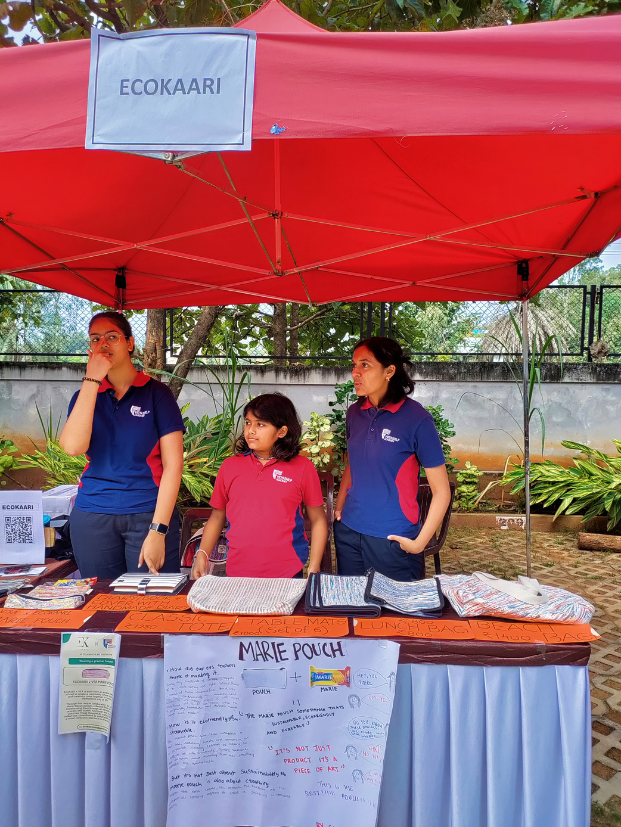
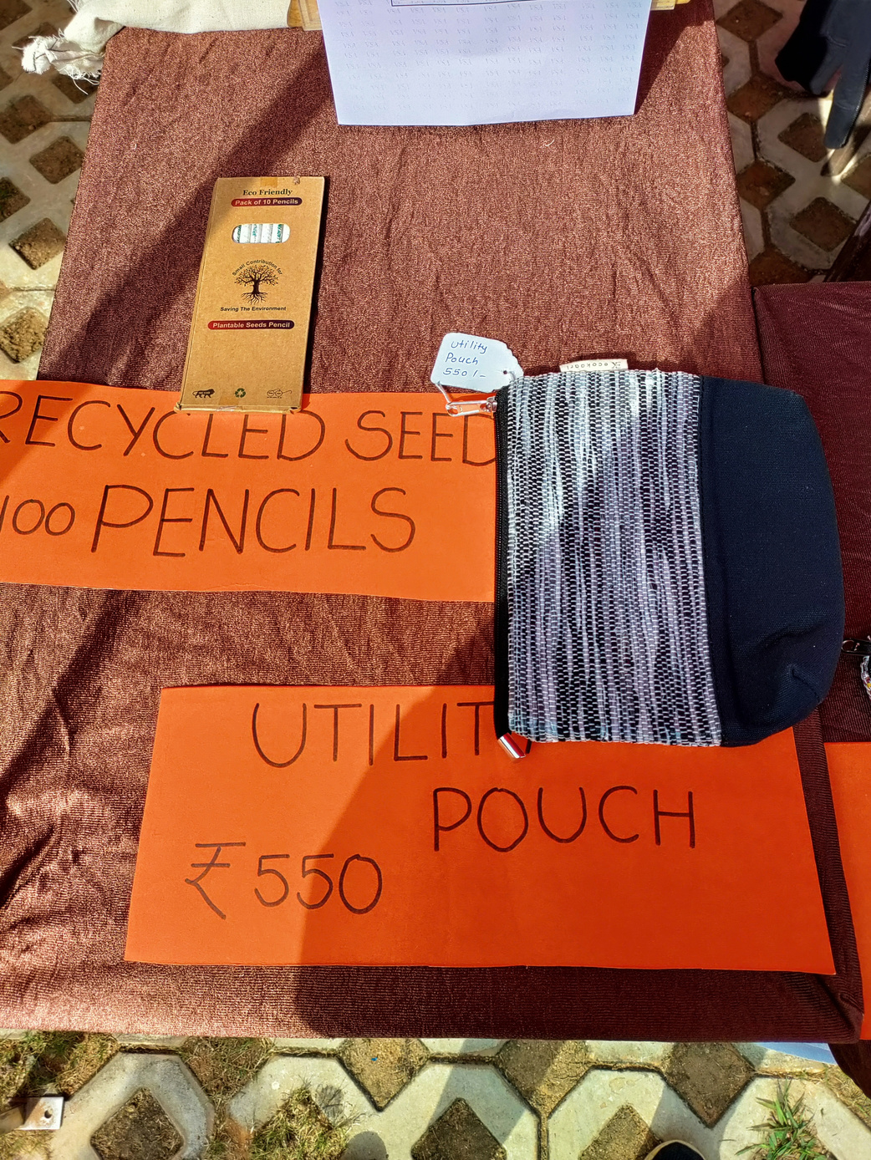

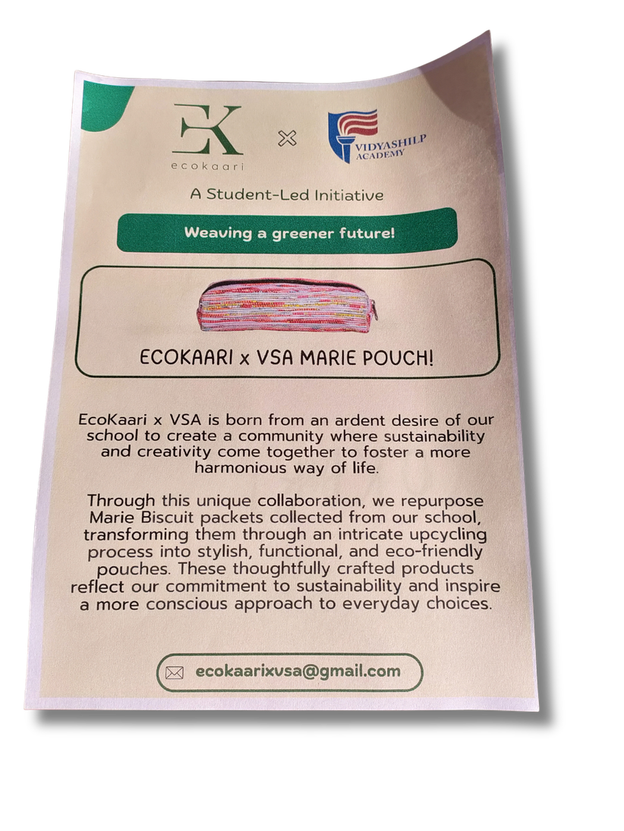
VSA MARIE POUCH
  Snack wrappers generated on campus are collected, particularly from the school’s evening snack service, which caters to 3,000+ students and staff.
  The initiative promotes plastic waste reduction, creative reuse.
Students actively participated in making the products, gaining hands-on experience in preparing, assembling, and creatively repurposing plastic wrappers, while developing practical skills and entrepreneurial awareness.

Slide 12

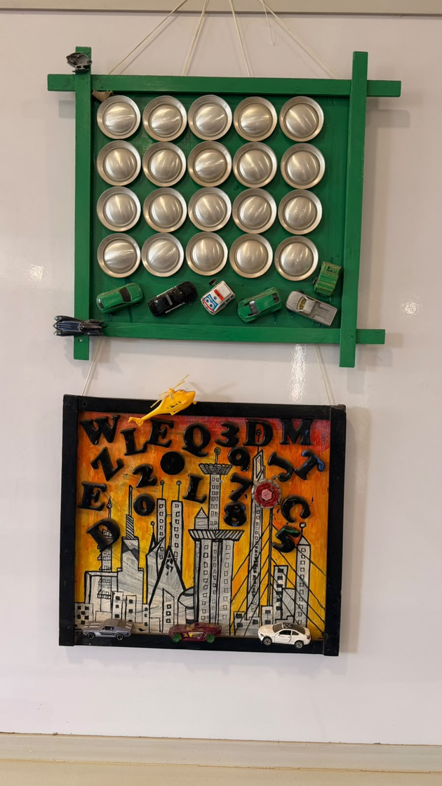
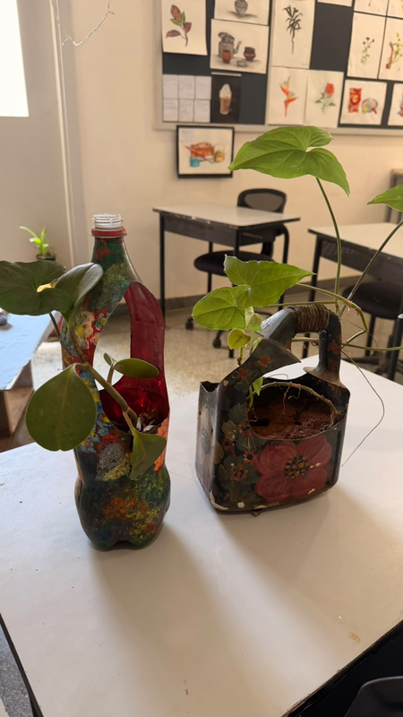
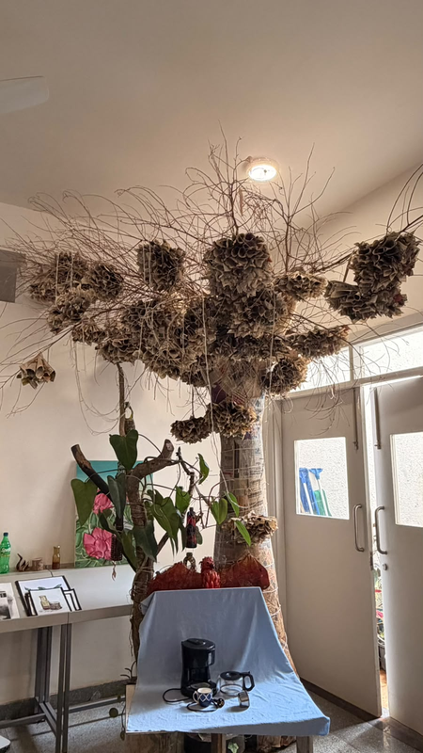
Waste to Product - Turning Discarded Materials into Useful Products
AN INITIATIVE BY THE VIDYASHILP ACADEMY- ART DEPARTMENT

Slide 13

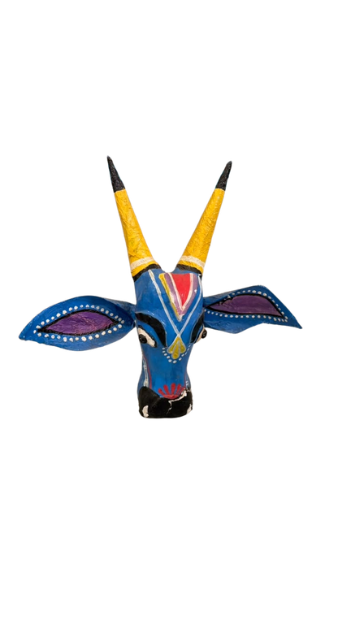


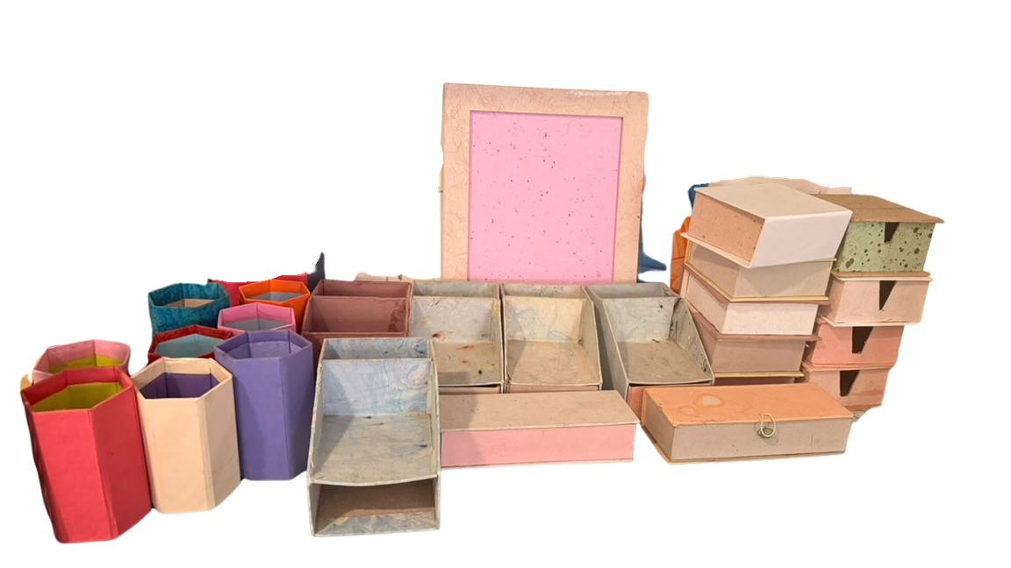
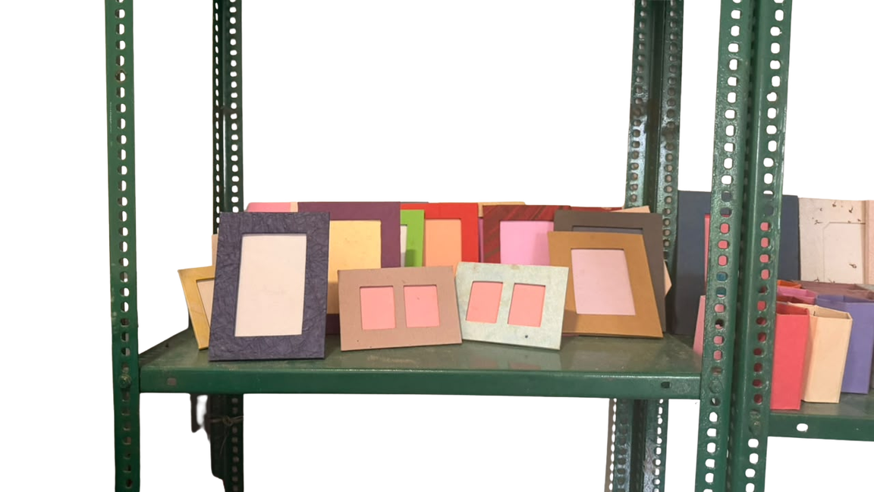
Campus Paper Recycling and
Waste-to-Product Initiative
Waste to Product - Turning Discarded papers into Useful Products

Slide 14




Textile Reuse & Fair-Trade Initiatives
Uniform Collection Drive & Fair Trade
The campaign created awareness about overconsumption, disposable fashion, textile waste, and the environmental impact of synthetic fibres such as polyester.
2,500 Vidyashilp students participated in the Fashion Revolution campaign. The campaign encouraged students to ask “Who Made My Clothes?” and understand the people and processes behind the clothes they wear.

Slide 15





Used Uniform and Clothing Collection Drive (July 2026)
The initiative connects directly with SDG 12: Responsible Consumption and Production, encouraging students to understand that clothing choices also create waste and environmental impacts.
    As part of a school sustainability initiative, students collected and sorted used uniforms and clothing for reuse, recycling, and upcycling.

Slide 16









Cloth Bag Making and Sustainable Reuse Initiative
Farmers’ Market at GKVK Campus
Reusable bags made from old clothes are promoted within the school as alternatives to plastic carry bags. Students also take this initiative to the nearby santhe (market), encouraging customers to use reusable bags instead of plastic carry bags.
Students distributed 1,000 paper bags and 55 cloth bags, encouraging market visitors to use paper bags as an alternative to plastic carry bags.

Slide 17



World Environment Day Initiative- E-Waste Collection at Campus
E-Waste Collection Drive
The initiative aimed to encourage the school community to recognise the importance of collecting electronic waste separately to promote responsible electronic waste management and environmental awareness.
Through the collection drive, the team collected 72 kilograms of e-waste.
The drive provided students with an opportunity to take part in a practical sustainability activity and contribute to a collective effort towards responsible waste management.

Slide 18


Waste Adventure at Vidyashilp Academy
Rooted in SDG 12 – Responsible Consumption and Production, Waste Adventure transformed learning into action through student speeches, creative DIY projects using recycled materials, and informative charts on responsible waste management. The activity encouraged students to reduce, reuse, and repurpose, showing how small, thoughtful choices can create meaningful change.
Scan the QR code to watch the Waste Adventure video and see our students in action.

Slide 19



Plastic Reduction, Substitution & Reuse
    Plastic-free dining practices: The school kitchen and dining areas use steel plates, spoons, glasses and other reusable utensils instead of disposable plastic alternatives.
    Reusable containers and bottles: Students are encouraged to use reusable bottles and containers, with durable alternatives such as steel and glass promoted in place of single-use plastic.
    Cloth bags over plastic covers: Reusable cloth bags and other sustainable alternatives are promoted for carrying materials and purchases instead of plastic carry bags.

Slide 20




Sewage Water Treatment Plant (STP)
Wastewater Treatment and Reuse
The school’s Sewage Treatment Plant (STP) treats wastewater generated across the campus. During the treatment process, solid waste/sludge is separated and removed from the system for appropriate disposal, while the treated water is reused for watering Shilp Udyan, the school garden..
Treatment capacity: 250,000 litres per day (250 KLD)
Daily water filtered: 10,000 litres

Slide 21


Water Conservation and Rainwater Harvesting
Clean Water and Sanitation
  The school captures runoff from its extensive rooftop and open areas to maximize water collection during monsoons.
  The school’s functioning rainwater harvesting system has a 750,000-litre storage capacity.
The school uses rainwater harvesting pits across its campus to recharge groundwater and promote environmental sustainability. Harvested rainwater is used for gardening and irrigation, helping conserve freshwater resources.

Slide 22



Kitchen Waste Management and Composting
Kitchen Waste Management Process
The organic material is converted into compost rather than being disposed of with general waste and the compost is used by the gardening team in the school garden, completing a resource-recovery cycle within the campus.
    Kitchen prepares meals for 3,000+ students and staff, generating daily organic waste.
    Vegetable peels, fruit peels, and other biodegradable waste are collected separately.
    Collected waste is taken to the campus composting area.
    Organic waste is converted into vermicompost through the earthworm-based composting process.

Slide 23

Smart Vermicompost System - ATL Changemaking Initiative
ATL Student Innovation
As part of the Atal Tinkering Lab (ATL) Changemaking initiative, students identified a challenge in the school’s organic waste management process and they developed the system connects technology with the school’s existing kitchen-waste management efforts.
  Students recognised that manually segregating organic waste and managing the vermicomposting process could be difficult to sustain efficiently.
  To address this challenge, they designed and developed a Smart Vermicompost System, which has been deployed on the school campus.

Slide 24



Kitchen Waste Management and Composting
Kitchen Waste Management Process
The finished vermicompost and the treated water from the STP is then used in Shilp Udyan, the school garden, where it supports soil enrichment and plant growth.
Through the school’s vermicomposting initiative, suitable organic waste is processed with the help of earthworms and converted into nutrient-rich vermicompost.

Slide 25

Seasonal Water Quality Assessment – Gantiganahalli Lake
Water Testing to Lake Restoration
  Seasonal water samples were collected and analysed for key physicochemical parameters such as pH, TDS, electrical conductivity, cations and anions.
  Results indicated that several parameters exceeded permissible limits.
  Findings encouraged scientific inquiry and student-led lake conservation.
Students from Grade 10-12 conducted seasonal water quality assessments at Gantiganahalli Lake near the school to understand changes in water conditions over time and investigate signs of environmental deterioration.

Slide 26


Lake clean-up drive by our students
Community-Based Environmental Initiative
It demonstrates citizen science in practice- students collected evidence, interpreted environmental conditions, identified concerns, and participated in a solution.
Based on their observations, students took action by organising and participating in a lake clean-up drive, removing significant quantities of litter.

Slide 27

Environmental Awareness Programmes in Nearby Government Schools
Student-Led Outreach
Through these outreach activities and campaigns encourage students and the wider community to reduce waste, segregate it responsibly, and adopt environmentally conscious habits.
Students conduct awareness campaigns within the school and nearby government schools to promote responsible waste management and sustainable practices.
Students visited Gantegehalli Government Primary School and Harohalli Government Primary School

Slide 28

Summarizing the Key Sustainability Initiatives at Vidyashilp Academy
    Plastic-Free Campus – Steel plates, cups and utensils, glass bottles, reusable tiffins, and cloth/paper bags promoted instead of single-use plastic.
    Paper Recycling & Upcycling – Used paper converted into notebooks, books, paper bags, files, and other useful products.
    Plastic Wrapper Upcycling – EcoKary Collaboration – Chocolate and biscuit wrappers transformed into school bags and other useful products with student participation.
    Kitchen Waste Management & Vermicomposting – Vegetable and fruit waste converted into vermicompost and used in Shilp Udyan.
    Smart Vermicompost System – ATL Changemaking Initiative – Students developed and deployed a technology-based vermicomposting solution on campus.
    Sewage Treatment Plant (STP) – The campus operates a 250 KLD STP, treating wastewater for reuse in gardening and irrigation, supporting water conservation and responsible water management.

Slide 29
Summarizing the Key Sustainability Initiatives at Vidyashilp Academy
    Rainwater Harvesting – The school’s functioning rainwater harvesting system has a storage capacity of 750,000 litres, with harvested water used for gardening and irrigation.
    E-Waste and Used Cloth Collection Drive – 72 kg of e-waste, and used clothes for recycling collected through the World Environment Day initiative.
    Creative Waste Adventure – Student speeches, recycled-material DIY projects, and charts promoting SDG 12.
    Student Waste Awareness & Community Outreach – Worksheets, posters, and awareness programmes conducted within the school and nearby government schools.
    Seasonal Water Quality Assessment – Students from Grade 10-12 conducted seasonal water quality assessments at Gantiganahalli Lake near the school
    Lake Revival – Students collected and segregated waste from the community lake and handed it over to BBMP for further management.

Slide 30

OUR COMMITMENT TO A SUSTAINABLE CAMPUS
Towards a Self-Sustaining School Ecosystem
Through the Academy Programme, Vidyashilp Academy has developed a holistic approach to sustainability, segregating waste, recycling paper into useful products, upcycling plastic, promoting responsible textile consumption, converting kitchen waste into vermicompost for the school garden, reusing treated wastewater, and responsibly managing e-waste.
These efforts extend beyond the campus through various ongoing initiative led by our students, teachers and support staffs.
Most importantly, students are at the heart of this ecosystem.The greatest learning happens when students identify real problems, think critically about consumption, create solutions, implement them, and see their impact around them.

Slide 31



